Slide 1
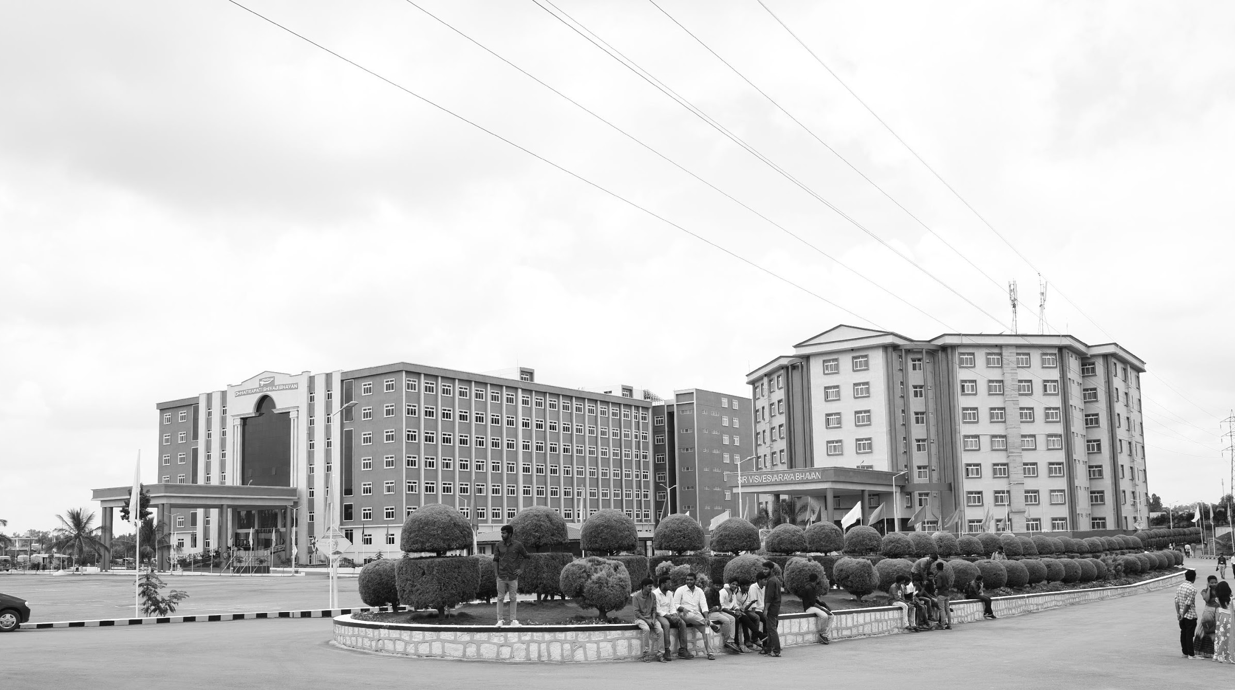

Review-I
Design and Development of a
Solar E-Bicycle with an Embedded based Smart Monitoring System
AY 2025-26
Capstone Project – Introduction (PROJ2999)
GITAM (Deemed-to-be) University
Department of Electrical Electronics and Communication Engineering
Project Team:
Karthik S
Manasanthosh Y
Salomi S
Rakshitha N
Project Mentor:
Dr. Seetha Chaithanya
Project In-charge:
Dr. Kshitij Shakya
www.gitam.edu

Slide 2
Objective and Goals
Objective
To design and develop a solar-powered electric bicycle with an IoT dashboard that utilizes renewable energy, provides real-time monitoring, and promotes safe, smart, and sustainable urban mobility.
Goals
Main Goals
Solar + plug-in charging (continuous battery)
BLDC hub motor drive (efficient & sustainable)
IoT dashboard (battery, speed, distance, solar status)
Smartphone connectivity (performance data & alerts)

Slide 3
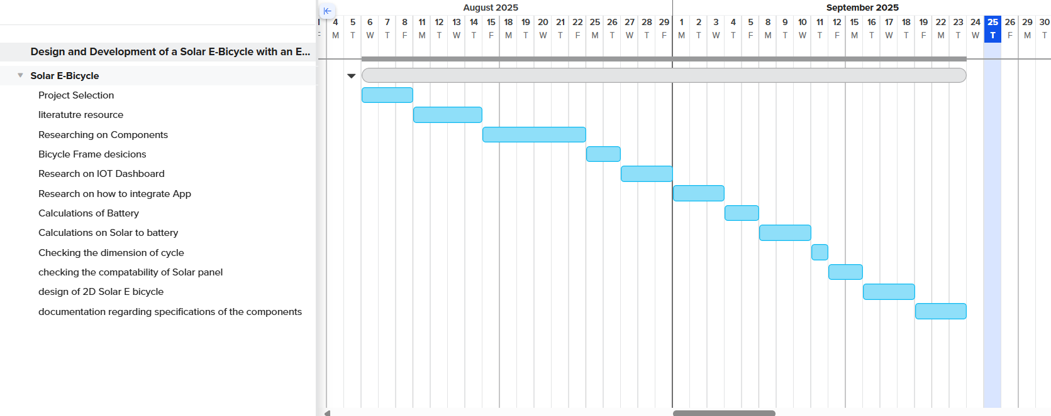
Project Plan (Clearly mention milestone for objectives under each reviews)

Slide 4
Literature Survey
Publications:
Solar-powered bicycle techniques – T. Suresh (2021)
Solar vehicle design – Hema Latha, (2019)
Solar bicycle implementation – P. Maheswara Rao, (2024)
E-bike sharing systems – S. Adhisuwignjo, (2017)
Key Resources:
BLDC motor & controller guides
Battery & BMS datasheets
MPPT charge controller datasheets
Standards: IEC 62133, IEEE 1562, IS
Existing Implementations:
Open-source e-bike hardware/software
DIY modular controllers & displays
E-bike analytics & instrumentation repositories

Slide 5
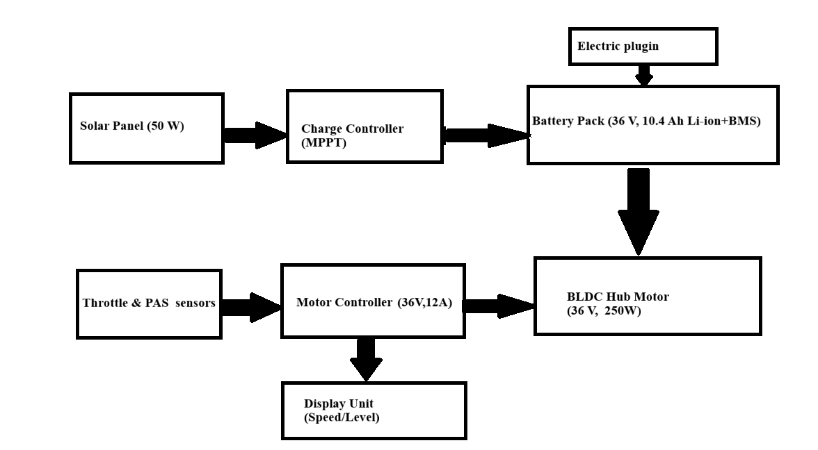
Architecture for Solar E - bicycle

Slide 6
Use Cases
Use Cases
Useful for connecting commuters from public transport hubs (bus, metro, train stations) to their final destination.
Solar e-bikes can be rented for sightseeing, campus rides, or eco-tourism projects.
Lower operational and maintenance costs compared to petrol-based vehicles.
Solar charging further reduces electricity expenses.

Slide 7
Main Components required for the project
Brushless DC HUB motor (BLDC) (36V,250 W)
Trapezoidal Controller (36V)
Solar panel (50W)
Maximum power point tracking controller (MPPT) (12/24V)
STM 32
Liquid Crystal display (LCD)

Slide 8
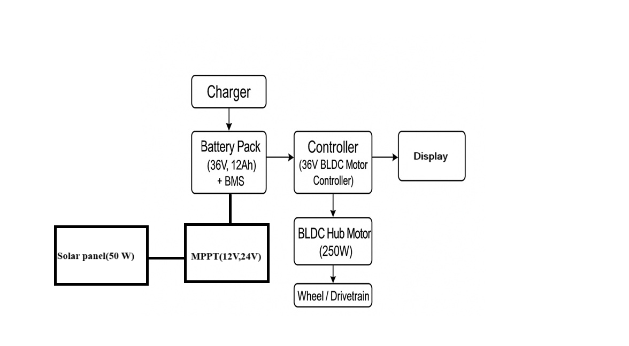
Integration of Hardware components
Brushless DC HUB motor (BLDC) (36V,250 W)
Trapezoidal Controller (36V)
Solar panel (50W)
Maximum power point tracking controller
(MPPT) (12/24V)

Slide 9
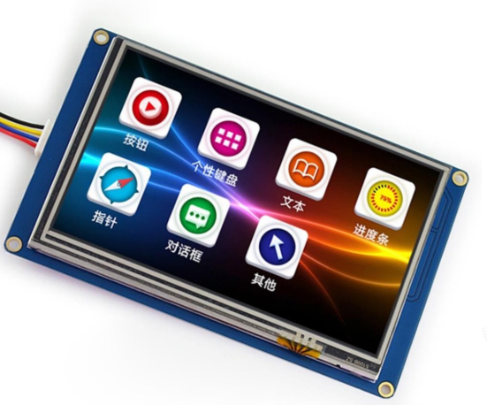
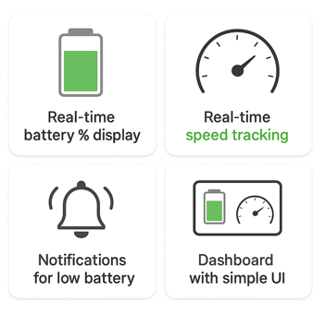
The Integration of IOT Dashboard for real time monitoring
Monitoring Features
Real-time Monitoring
Battery %, speed, distance, solar input
Performance Insights
Trip history, energy usage
App & Connectivity
Smartphone App
Live data & alerts
Connectivity
Bluetooth / Wi-Fi integration

Slide 10
Conclusion & Future Work
Summary and Conclusion
Future Work

Slide 11
THANK YOU
Have a Great Day !

